Slide 1
CSE 572: Hospital Costs Database
By Christopher Magnuson
Taylor Pedretti
Felipe Valadez
Zhenghao Zhou

Slide 2
Overview
The purpose of the database that we have created is to help patients determine the cheapest hospitals in their local area for a specific procedure that they are in need of. A recent law has mandated that hospitals provide pricing on procedures that is publicly available. However, the data is in large spreadsheets and is very hard for patients to access and obtain the information they need. Our database will solve this issue.

Slide 3
Introduction
Our database will help patients navigate the different pricing variations that occur throughout hospitals in their local area. It will most likely be useful for people that are having elective procedures and other non-life threatening procedures. They will have the ability to research local hospitals and find a hospital that offers them best value. For years consumers have been able to price shop different items that they are interested in purchasing. The time has come for the consumer to have this same option when dealing with medical procedures.

Slide 4
Introduction
In China, the national database provides users with professional classification of Chinese medical research, new medicine, professional hospitals, famous doctors' research results and pathological health information according to Chinese domestic disease departments and domestic common diseases, to facilitate more targeted and accurate access and there is a new database of the citizen which can record every citizen`s medical history. And our system will provide a similar service of the old Chinese database.

Slide 5
Entities
Hospital
Location
Countries
Regions
Reviews
Service
Users
Doctor

Slide 6
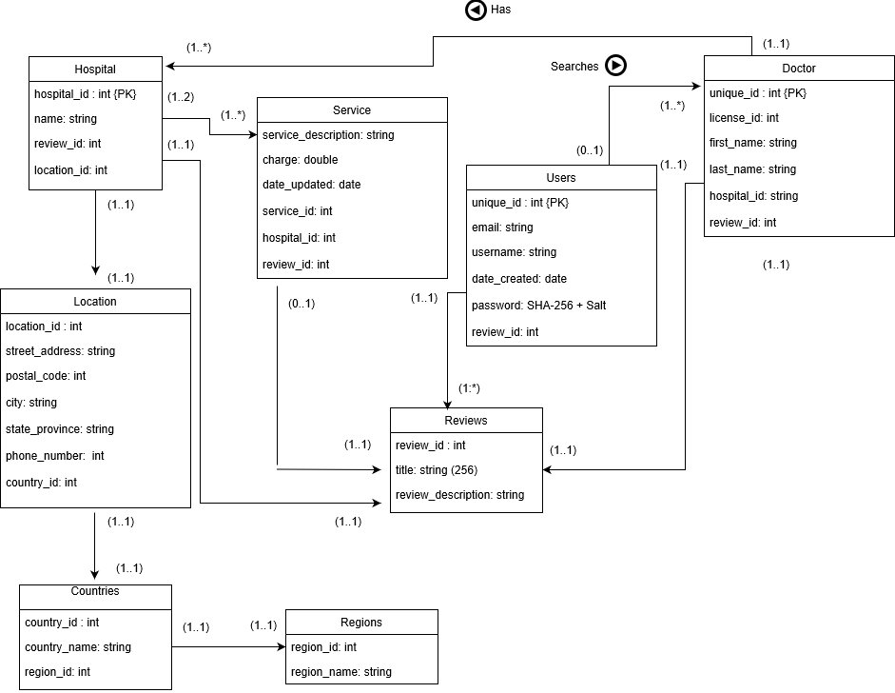
Entity Relation Diagram

Slide 7
Create Statement
CREATE TABLE serviceinfo
(
service_id number(10) NOT NULL PRIMARY KEY,
hospital_procedure_code varchar(4000),
service_name varchar(4000),
service_description varchar(4000),
charge binary_double,
date_updated date,
hospital_id number(10) NOT NULL,
review_ids varchar(4000),
HCPCS_id varchar(4000)
);
ALTER TABLE locationinfo ADD CONSTRAINT country_fk FOREIGN KEY (country_id) REFERENCES countries(country_id);
ALTER TABLE countries ADD CONSTRAINT region_fk FOREIGN KEY (region_id) REFERENCES region(region_id);
ALTER TABLE hospitalinfo ADD CONSTRAINT location_fk FOREIGN KEY (location_id) REFERENCES locationinfo(location_id);
ALTER TABLE serviceinfo ADD CONSTRAINT hospital_fk FOREIGN KEY (hospital_id) REFERENCES hospitalinfo(hospital_id);

Slide 8
Insert Statement
INSERT INTO
locationinfo(location_id, street_address, postal_code, city, state_province, phone_number, country_id)
SELECT 1, '400 N Pepper Ave', 92324, 'Colton', 'CA', '909-580-1000', 840 FROM dual UNION ALL
SELECT 2, '820 E Mountain View St', 92311, 'Barstow', 'CA', '760-256-1761', 840 FROM dual UNION ALL
SELECT 3, '5451 Walnut Ave', 91710, 'Chino', 'CA', '909-464-8600', 840 FROM dual UNION ALL
SELECT 4, '800 S Main St’, 92882, 'Corona', 'CA', '951-737-4343', 840 FROM dual;
INSERT INTO HCPCSCodes
SELECT '80061',NULL,'Lipid panel','310' FROM dual UNION ALL
SELECT '80069',NULL,'Renal function panel','310' FROM dual UNION ALL
SELECT '80074',NULL,'Acute hepatitis panel','220' FROM dual UNION ALL
SELECT '80076',NULL,'Hepatic function panel','310' FROM dual UNION ALL
SELECT '80081',NULL,'Obstetric panel','210, 220, 400, 510, 520' FROM dual UNION ALL
SELECT '80150',NULL,'Assay of amikacin','340' FROM dual UNION ALL
SELECT '80155',NULL,'Drug assay caffeine','340' FROM dual UNION ALL
SELECT '80156',NULL,'Assay, carbamazepine, total','340' FROM dual UNION ALL
...
OVER 20,000 INSERT STATEMENTS ALONE FROM ONLY 3 HOSPITALS!!! CRAZY!

Slide 9
Triggers
CREATE SEQUENCE user_seq START WITH 1 INCREMENT BY 1;
CREATE OR REPLACE TRIGGER user_seq
BEFORE INSERT ON users
FOR EACH ROW
WHEN (new.unique_id IS NULL)
BEGIN
SELECT user_seq.NEXTVAL
INTO :new.unique_id
FROM dual;
END;
/
CREATE SEQUENCE review_seq START WITH 1 INCREMENT BY 1;
CREATE OR REPLACE TRIGGER review_seq
BEFORE INSERT ON reviews
FOR EACH ROW
WHEN (new.review_id IS NULL)
BEGIN
SELECT review_seq.NEXTVAL
INTO :new.review_id
FROM dual;
END;
/

Slide 10
Select Statement
select service_name as "Service Name", charge as "Price" from serviceinfo where charge>5000;
select service_name as "Service Name", charge as "Price", service_description as "Description" from serviceinfo where upper(hospital_procedure_code) like ('06600019’);
Service Name | Price
IR THROMBECT MECH ART INIT ADD | 6580
LVIS HR 3.5X23 STENT | 15231
… | …
Service Name | Price
ROOM AND CARE - NICU | 6952

Slide 11
Views
-- View for finding all services with x-ray within the name --
create view xray as select s.service_name as "Service Name", s.charge as "Price" from serviceinfo s where upper(s.service_name) like upper('%x-ray%') or upper(s.service_name) like upper('%x ray%') or upper(s.service_name) like upper('%xray%');
-- Display all hospitals in the US based off of ISO 3166-1 codes --
create view usHospitalInfo as select h.hospital_name as "Hospital Name", l.street_address as "Address", l.city as "City", l.state_province as "State", l.postal_code as "Postal Code", l.phone_number as "Phone Number" from locationinfo l, hospitalinfo h where (l.location_id = h.location_id) and l.country_id=840;
-- View all services with the hcpcs id of Z7610 --
create view serviceinfo as select s.service_name as "Service Name", s.charge as "Price", hc.description as "HCPCS Des" from serviceinfo s, HCPCSCodes hc where upper(s.HCPCS_id) like upper('Z7610');

